Slide 1
UART
LPC2148

Slide 2
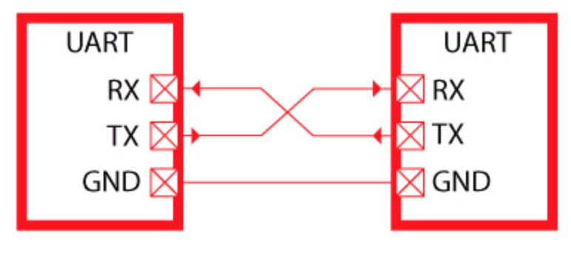
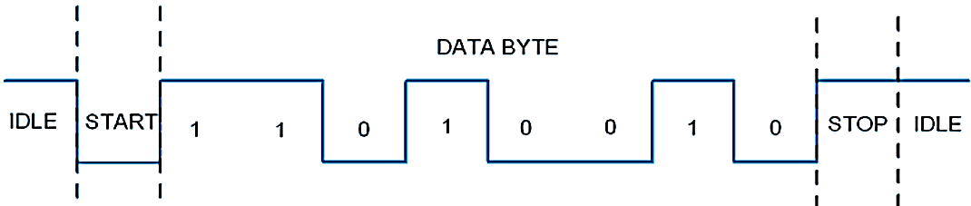
Introduction
UART (Universal Asynchronous Receiver/Transmitter) is a serial communication protocol in which data is transferred serially bit by bit at a time. Asynchronous serial communication is widely used for byte oriented transmission. In Asynchronous serial communication, a byte of data is transferred at a time.
UART serial communication protocol uses a defined frame structure for their data bytes. frame consists of a START bit (1 bit) followed by a data byte (8 bits) followed by a parity bit and then a STOP bit (1 bit). Frame structure in Asynchronous communication consists :
START bit: It is a bit with which indicates that serial communication has started and it is always logic low.
Data bits packet: Data bits can be packets of 5 to 9 bits. Normally we use 8 bit data packet, which is always sent after the START bit.
STOP bit: This usually is one or two bits in length. It is sent after data bits packet to indicate the end of frame. Stop bit is always logic high.

Slide 3
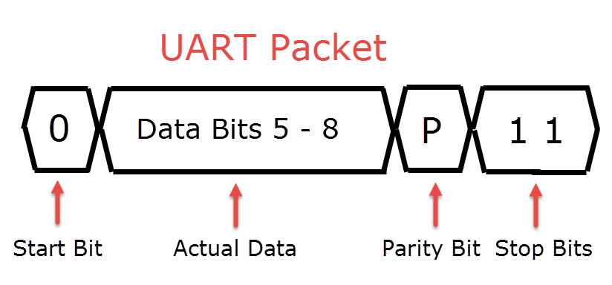
Basics of UART
The UART Protocol uses only two wires (or pins in a device like microcontroller) to transmit the data. In that, one is for transmitting the data and the pin is called TX pin in the device. The other pin is used to receive the data and is called RX pin.
As UART is a serial communication, the data is transmitted in a series of packets. Usually, a packet consists of 4 parts: a start bit, the actual data, a parity bit and stop bits. The following image shows a typical structure of the data packet in UART.

Slide 4
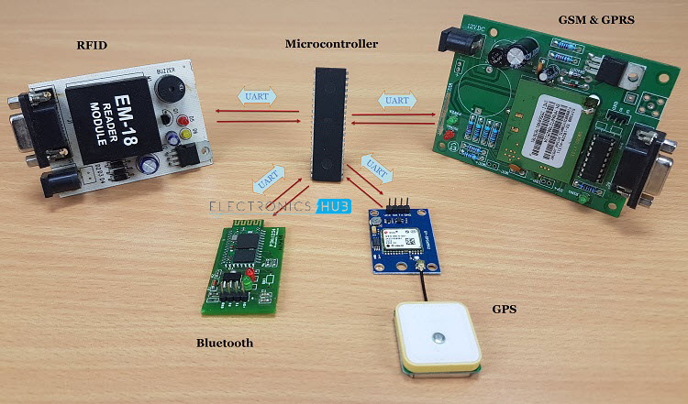

Slide 5
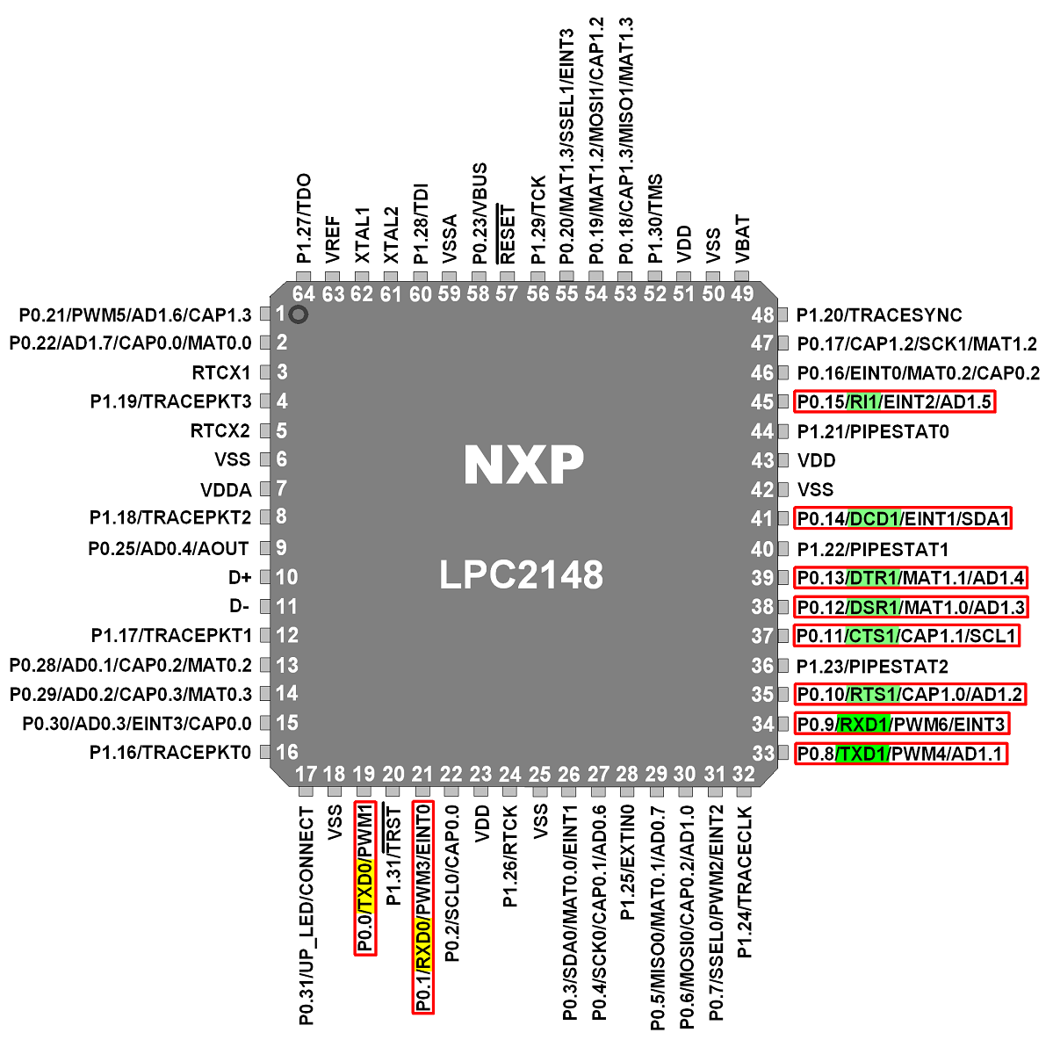
LPC2148 UART Pins

Slide 6
LPC2148 UART communication
LPC2148 has two inbuilt UARTs i.e. UART0&UART1.
UART module and registers. LPC2148 has 2-UARTs numbering 0-3, similarly, the pins are also named as RXD0-RXD1 and TXD0-TXD1.
Port Pin | Pin Number | PINSEL_FUNC_0 | PINSEL_FUNC_1 | PINSEL_FUNC_2 | PINSEL_FUNC_3
P0.0 | 19 | GPIO | TXD0 | PWM1
P0.1 | 21 | GPIO | RXD0 | PWM3 | EINT0
P0_8 | 33 | GPIO | TXD1 | PWM4 | AD1.1
P0.9 | 34 | GPIO | RXD1 | PWM6 | EINT3

Slide 7
Features
Features of UART0
16 byte Receive and Transmit FIFOs
Built-in fractional baud rate generator with autobauding capabilities
Software flow control through TXEN bit in Transmit Enable Register
Features of UART1
16 byte Receive and Transmit FIFOs
Built-in fractional baud rate generator with autobauding capabilities
Software and hardware flow control implementation possible
Standard modem interface signals included with flow control (auto-CTS/RTS) fully supported in hardware

Slide 8
LPC2148 UART Pins

Slide 9
UART Pins
UART0
TXD0 (Output pin): Serial Transmit data pin.
RXD0 (Input pin): Serial Receive data pin.
UART1 :
TXD1 (Output pin): Serial Transmit data pin.
RXD1 (Input pin): Serial Receive data pin.

Slide 10
UART1 Pins
RTS1 (Output pin): Request To Send signal pin. Active low signal indicates that the UART1 would like to transmit data to the external modem.
CTS1 (Input pin): Clear To Send signal pin. Active low signal indicates if the external modem is ready to accept transmitted data via TXD1 from the UART1.
DSR1 (Input pin): Data Set Ready signal pin. Active low signal indicates if the external modem is ready to establish a communication link with the UART1.
DTR1 (Output pin): Data Terminal Ready signal pin. Active low signal indicates that the UART1 is ready to establish connection with external modem.
DCD1 (Input pin): Data Carrier Detect signal pin. Active low signal indicates if the external modem has established a communication link with the UART1 and data may be exchanged.
RI1 (Input pin): Ring Indicator signal pin. Active low signal indicates that a telephone ringing signal has been detected by the modem.

Slide 11
UART Registers
Register | Description
UxRBR | Contains the recently received Data
UxTHR | Contains the data to be transmitted
UxFCR | FIFO Control Register
UxLCR | Controls the UART frame formatting(Number of Data Bits, Stop bits)
UxDLL | Least Significant Byte of the UART baud rate generator value.
UxDLM | Most Significant Byte of the UART baud rate generator value.

Slide 12
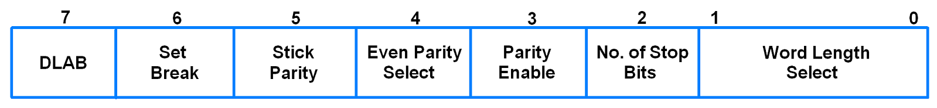
U0LCR (UART0 Line Control Register)
It is an 8-bit read-write register.
It determines the format of the data character that is to be transmitted or received.
Bit 1:0 - Word Length Select
00 = 5-bit character length
01 = 6-bit character length
10 = 7-bit character length
11 = 8-bit character length

Slide 13
U0LCR (UART0 Line Control Register)
Bit 2 - Number of Stop Bits 0 = 1 stop bit 1 = 2 stop bits
Bit 3 - Parity Enable 0 = Disable parity generation and checking 1 = Enable parity generation and checking
Bit 5:4 - Parity Select 00 = Odd Parity 01 = Even Parity 10 = Forced “1” Stick Parity 11 = Forced “0” Stick Parity
Bit 6 - Break Control 0= Disable break transmission 1 = Enable break transmission
Bit 7 - Divisor Latch Access Bit (DLAB) 0 = Disable access to Divisor Latches 1 = Enable access to Divisor Latches

Slide 14
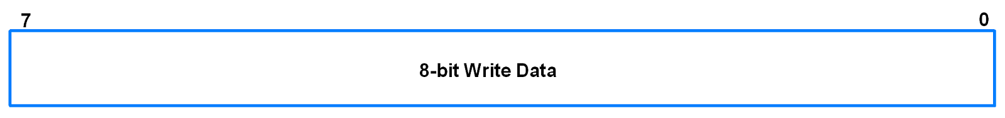
U0THR (UART0 Transmit Holding Register)
It is an 8-bit write only register.
Data to be transmitted is written to this register.
It contains the “newest” received byte in the transmit FIFO.
The Divisor Latch Access Bit (DLAB) in U0LCR must be zero in order to access theU0THR. (DLAB = 0)

Slide 15
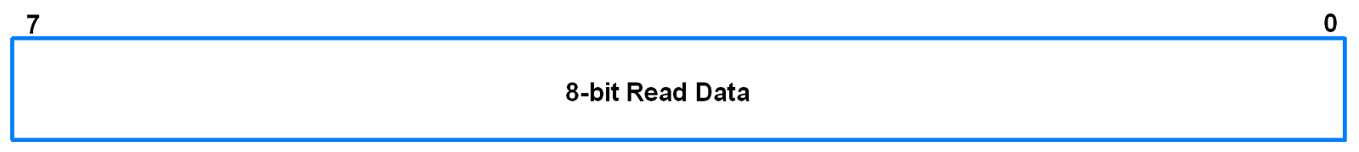
U0RBR (UART0 Receive Buffer Register)
It is an 8-bit read only register.
This register contains the received data.
It contains the “oldest” received byte in the receive FIFO.
If the character received is less than 8 bits, the unused MSBs are padded with zeroes.
The Divisor Latch Access Bit (DLAB) in U0LCR must be zero in order to access the U0RBR. (DLAB = 0)

Slide 16
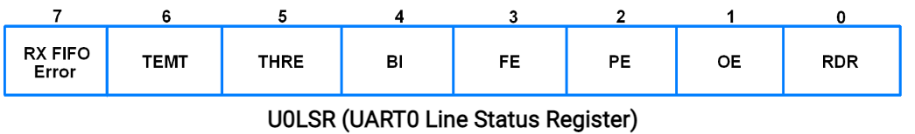
U0LSR (UART0 Line Status Register)
It is an 8-bit read only register.
Bit 5 - Transmitter Holding Register Empty 0 = U0THR has valid data 1 = U0THR empty
Bit 6 - Transmitter Empty 0 = U0THR and/or U0TSR contains valid data 1 = U0THR and U0TSR empty
Bit 0 - Receiver Data Ready 0 = U0RBR is empty 1 = U0RBR contains valid data

Slide 17
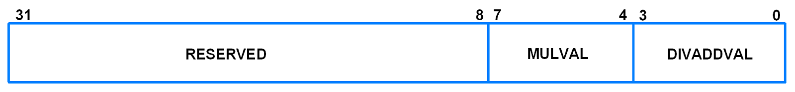
U0FDR (UART0 Fractional Divider Register)
It is a 32-bit read write register.
It decides the clock pre-scalar for baud rate generation.
If fractional divider is active (i.e. DIVADDVAL>0) and DLM = 0, DLL must be greater than 3.

Slide 18
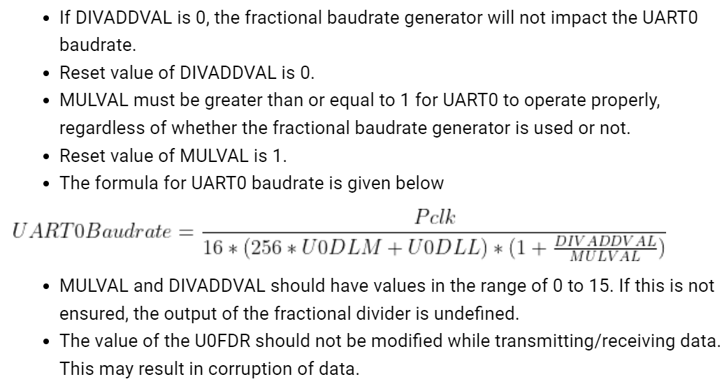

Slide 19
U0DLL and U0DLM (UART0 Divisor Latch Registers)
U0DLL is the Divisor Latch LSB.
U0DLM is the Divisor Latch MSB.
These are 8-bit read-write registers.
UART0 Divisor Latch holds the value by which the PCLK(Peripheral Clock) will be divided. This value must be 1/16 times the desired baud rate.
A 0x0000 value is treated like a 0x0001 value as division by zero is not allowed.
The Divisor Latch Access Bit (DLAB) in U0LCR must be 1 in order to access the UART0 Divisor Latches. (DLAB = 1)

Slide 20
Programming of UART0
1. Initialization of UART0
Configure P0.0 and P0.1 as TXD0 and RXD0 by writing 01 to the corresponding bits in PINSEL0.
Using U0LCR register, make DLAB = 1. Also, select 8-bit character length and 1 stop bit.
Set appropriate values in U0DLL and U0DLM depending on the PCLK value and the baud rate desired. Fractional divider can also be used to get different values of baudrate.
Example,
PCLK = 15MHz. For baud rate 9600, without using fractional divider register, from the baud rate formula, we have,9600 = \frac{15000000}{16 * (256 * U0DLM + U0DLL)} * \frac{MulVal}{MulVal + DivAddVal}
On reset, MulVal = 1 and DivAddVal = 0 in the Fractional Divider Register.
Hence, ( 256 x U0DLM + U0DLL ) = \frac{15000000}{16 * 9600}
( 256 x U0DLM + U0DLL ) = 97.65
We can consider it to be 98 or 97. It will make the baud rate slightly less or more than 9600. This small change is tolerable. We will consider 97.
Since 97 is less than 256 and register values cannot contain fractions, we will take U0DLM = 0. This will give U0DLM = 97.
Make DLA = 0 using U0LCR register.

Slide 21
Programming of UART0
void UART0_init(void) { PINSEL0 = PINSEL0 | 0x00000005; /* Enable UART0 Rx0 and Tx0 pins of UART0 */
U0LCR = 0x83; /* DLAB = 1, 1 stop bit, 8-bit character length */
U0DLM = 0x00; /* For baud rate of 9600 with Pclk = 15MHz */
U0DLL = 0x61; /* We get these values of U0DLL and U0DLM from formula */
U0LCR = 0x03; /* DLAB = 0 */ }

Slide 22
Programming of UART0
2. Receiving character
Monitor the RDR bit in U0LSR register to see if valid data is available in U0RBR register.
unsigned char UART0_RxChar(void) /*A function to receive a byte on UART0 */
{
while( (U0LSR & 0x01) == 0); /*Wait till RDR bit becomes 1 which tells that receiver contains valid data */
return U0RBR;
}

Slide 23
Programming of UART0
3. Transmitting character
Monitor the THRE bit in U0LSR register. When this bit becomes 1, it indicates that U0THR register is empty and the transmission is completed.
void UART0_TxChar(char ch) /*A function to send a byte on UART0 */
{
U0THR = ch; while( (U0LSR & 0x20) == 0 ); /* Wait till THRE bit becomes 1 which tells that transmission is completed */
}

Slide 24
References
https://www.exploreembedded.com/wiki/LPC2148_UART_Programming
https://www.electronicwings.com/arm7/lpc2148-uart0
https://www.electronicshub.org/basics-uart-communication/

Slide 25
Thank You… ☺

Slide 26
13,16,20,31.43,58,67,

